Slide 1
Research Award Funding Data

Slide 2
Agenda
Primer on Data
Demo Excel Workbook
Preview EDW Tool
Additional Resources

Slide 3
Data Primer

Slide 4
Data Primer – Basic Formula, Workday
Formula for summing awards with WD data
Original Amount
+
Budget Amendments
Total Award Dollars =

Slide 5
Data Primer – Overview of Key Changes to Awards
Item | Pre-Workday | Workday – Grant Method | Workday – Primary Grant Method
Where is it counted? | Org code receiving funding | Cost center associated with the GR line that ended up with the money | Cost center associated with the Primary GR line
What is counted? | Funding actions | Original amounts Budget amendments (increase, decrease, revision) | Original amounts Budget amendments (increase, decrease, revision)
When is it counted? | Funding Action, first in GCA date | Original amounts – award effective date Budget amendments – amendment date | Original amounts – award effective date Budget amendments – amendment date

Slide 6
Data Primer – Overview of Key Changes to Awards
Item | Pre-Workday | Workday – Grant Method | Workday – Primary Grant Method
Where is it counted? | Org code receiving funding | Cost center associated with the GR line that ended up with the money | Cost center associated with the Primary GR line
Example: COE receives $1M award but sends $100K to a SOM grant line. This method shows:
COE = $900K
SOM = $100K

Slide 7
Data Primer – Overview of Key Changes to Awards
Item | Pre-Workday | Workday – Grant Method | Workday – Primary Grant Method
Where is it counted? | Org code receiving funding | Cost center associated with the GR line that ended up with the money | Cost center associated with the Primary GR line
Example: COE receives $1M award but sends $100K to a SOM grant line. This method shows:
COE = $1M
SOM = $0

Slide 8
Data Primer – Overview of Key Changes to Awards
Item | Pre-Workday | Workday – Grant Method | Workday – Primary Grant Method
What is counted? | Funding actions | Original amounts Budget amendments (increase, decrease, revision) | Original amounts Budget amendments (increase, decrease, revision)
Note: pre-WD FAs generally did not count decreases, deobligations, etc. This results in more accurate numbers in current state, but unfavorable comparisons to pre-Workday numbers

Slide 9
Data Primer – Overview of Key Changes to Awards
Item | Pre-Workday | Workday – Grant Method | Workday – Primary Grant Method
When is it counted? | Funding Action, first in GCA date | Original amounts – award effective date Budget amendments – amendment date | Original amounts – award effective date Budget amendments – amendment date
Note: Using award effective date for original amounts means that award figures can change if new awards are set up with an effective date that is backdated.

Slide 10
Data Primer – Overview of Key Changes to Awards
Item | Pre-Workday | Workday – Grant Method | Workday – Primary Grant Method
Where is it counted? | Org code receiving funding | Cost center associated with the GR line that ended up with the money | Cost center associated with the Primary GR line
What is counted? | Funding actions | Original amounts Budget amendments (increase, decrease, revision) | Original amounts Budget amendments (increase, decrease, revision)
When is it counted? | Funding Action, first in GCA date | Original amounts – award effective date Budget amendments – amendment date | Original amounts – award effective date Budget amendments – amendment date
This is the focus of the excel workbook and EDW tool

Slide 11
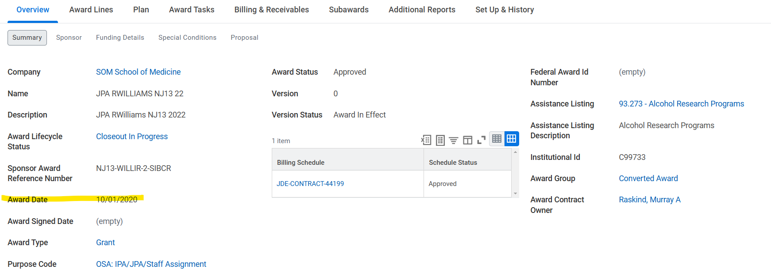
Data Primer –Award Effective Date
Date of “original amount” is based on the "award effective date" of the AWD. In WD this is shown as the "Award Date" on the AWD landing page

Slide 12
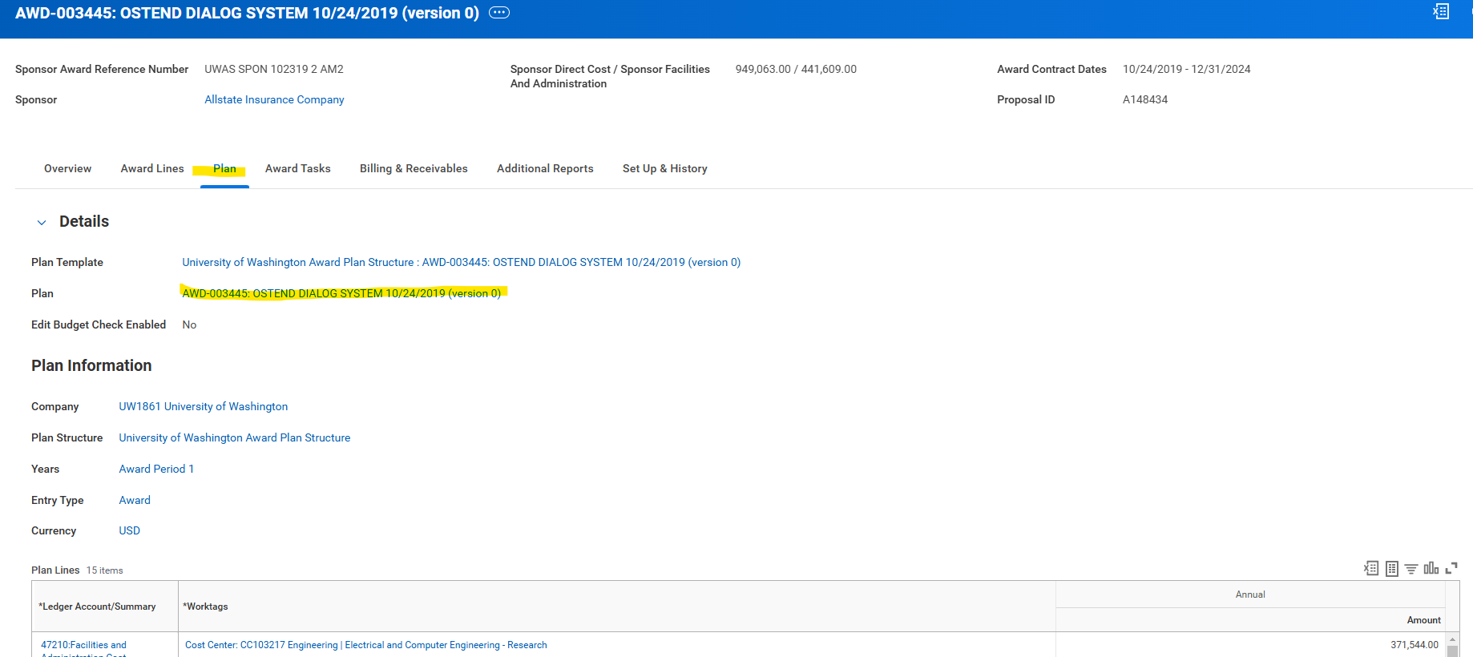
Data Primer – Amounts and Amendment Dates
Once you navigate to the main AWD landing page and click on the “Plan” tab (1), then click on the “Plan” link (2)
1
2

Slide 13
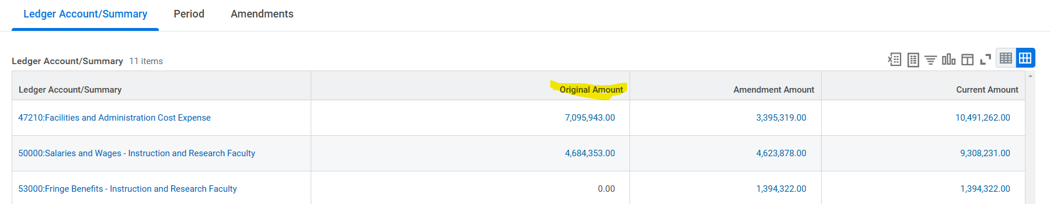
Data Primer – Original Amount Total
Original Amount is the funding applied to the AWD when it was first set up. This can be seen in the “view plan” section of an AWD page in WD

Slide 14
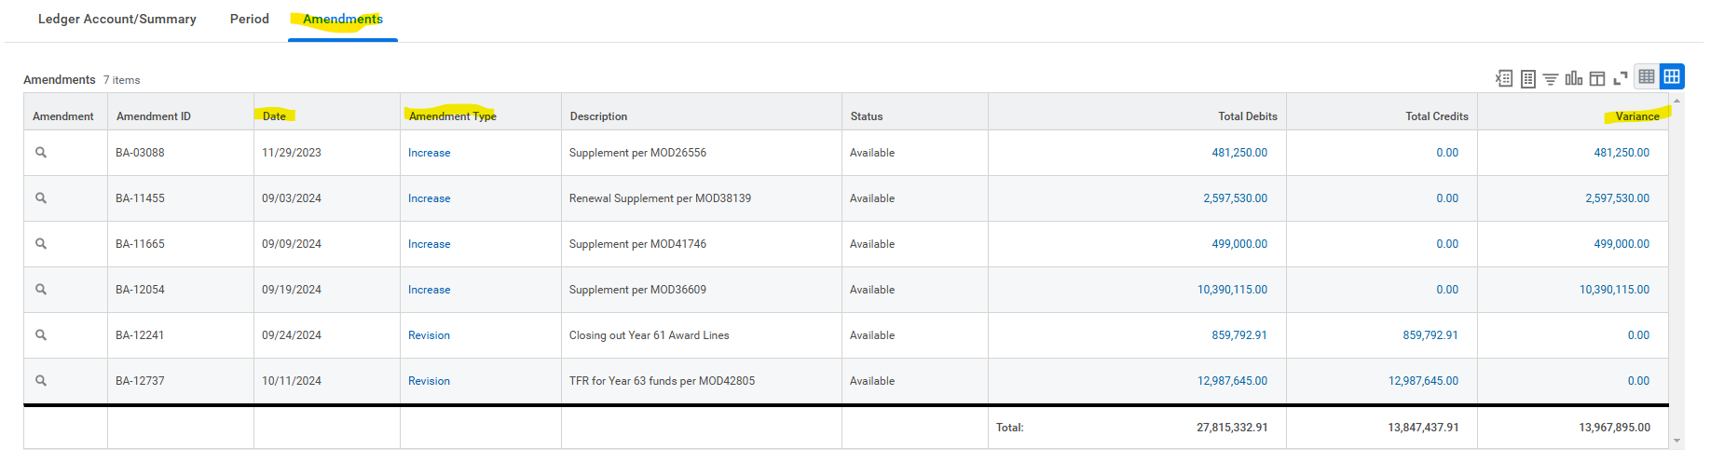
Data Primer – Budget Amendments Amount and Date
Budget amendments can add or subtract funds to an AWD after the AWD was first set up. This information can be found in the “Amendment” tab in the “view plan” section of an AWD page in WD

Slide 15
Demo Excel Workbook

Slide 16
Preview of EDW Report

Slide 17
Additional Resources

Slide 18
How to Access Research Enterprise Data
grantrpt@uw.edu for access to excel workbook demonstrated today
grantrpt@uw.edu for the SQL query that forms the basis for the workbook

Slide 19
Questions?

