Slide 1
Office of Research Strategic Framework
July 10, 2019

Slide 2
General Notes:
  Review Strategic Framework every other year: review, assess, look at this in reference to our annual goals.
Strategic Framework Visual Notes:
  Decide on keeping iSTAR as part of this framework, morphing the goals, or removing from our framework: Decision: iSTAR will be the umbrella under which the initiatives resides. We will keep the iSTAR web page and just organize the content around the strategic framework. Matt and I are working on a layout based on the framework and will share when we have it ready for review.
  Decide where to add the concept that the academic side of the house needs to inform our goals and strategies. How do we do this? Maybe discuss how we gather feedback through advisory groups, focus groups and customer satisfaction surveys. Decision: Discuss in L2 then L1
  Decide if our initiatives (now the arrow is 2007-2023) should be changed to 2019-2023). Decision: Yes. Remove iSTAR and changed the dates for the initiatives.

Slide 3
2. Strategic Framework Visual Notes (continued)
  d. Decide if our initiatives (now the arrow is 2007-2023) should be changed to 2019-2023). Decision: Yes. Remove iSTAR and changed the dates for the initiatives – confirm dates with L2.
  e. Edited the section “What are our drivers of change? Removed the box “Need to uphold service standards…This is a goal not a driver – delete.
Next Steps:
  Review/refine and update our content in the boxes and review with Mary. (DONE)
  Mary and Linda to work on next version. (DONE)
  Review updates and reasoning with L2 – update as needed then forward to Mary.
  Mary will review with AVPs. (Will ad d to agenda after L2 reviews)
  When final, review with: ExCom, and Communication team
  Later version: Create the framework so that if you click on a box, it will open with detailed content.

Slide 4
Office of Research Strategic Framework
Our Vision: The Office of Research will create an outstanding climate of support for University of Washington researchers, broadly enabling stellar research advances.
What will the future look like?
More data-driven and information focus
More
regulatory
More accountability to upper administration, public, legislators and media
More collaborative
Federal
requirements
Decreasing budgets
Need to stay
competitive
What are our drivers
of change?
Change in public perception
Environment of continuous change
What are our long-term goals?
Support and serve
our campus partners
Transform research administration
Invest in targeted initiatives to stay
globally competitive
Attain increased competitiveness in
research
Give time back to researchers so they can spend more time on research
Invest strategically and leverage resources
Navigate bureaucracy and lower barriers
What are our near-term goals?
Reduce administrative burden
Building Capacity in Research Administration through Information, Training, Automation
Giving Time Back to the Researcher
Reinventing Research Administration
2017-2023 Initiatives
Notes:
Notes:
Near-term goals. Could use iSTAR goals: Achieve operational excellence, Add value to the overall research experience, Add value to the UW, Attract and retain top diverse staff.
How/where do we communicate our strategy for gathering feedback (Customer satisfaction survey, and other methods)
Do we add something about our part in cultural change regarding diversity and exclusivity
Will add links to initiatives
Discuss plan for conducting a gap analysis – anything missing?
We used the models for 2y2d as an example (slides 4 and 5)
Discuss adding a detailed slide for our initiatives (see slide #4)

Slide 5

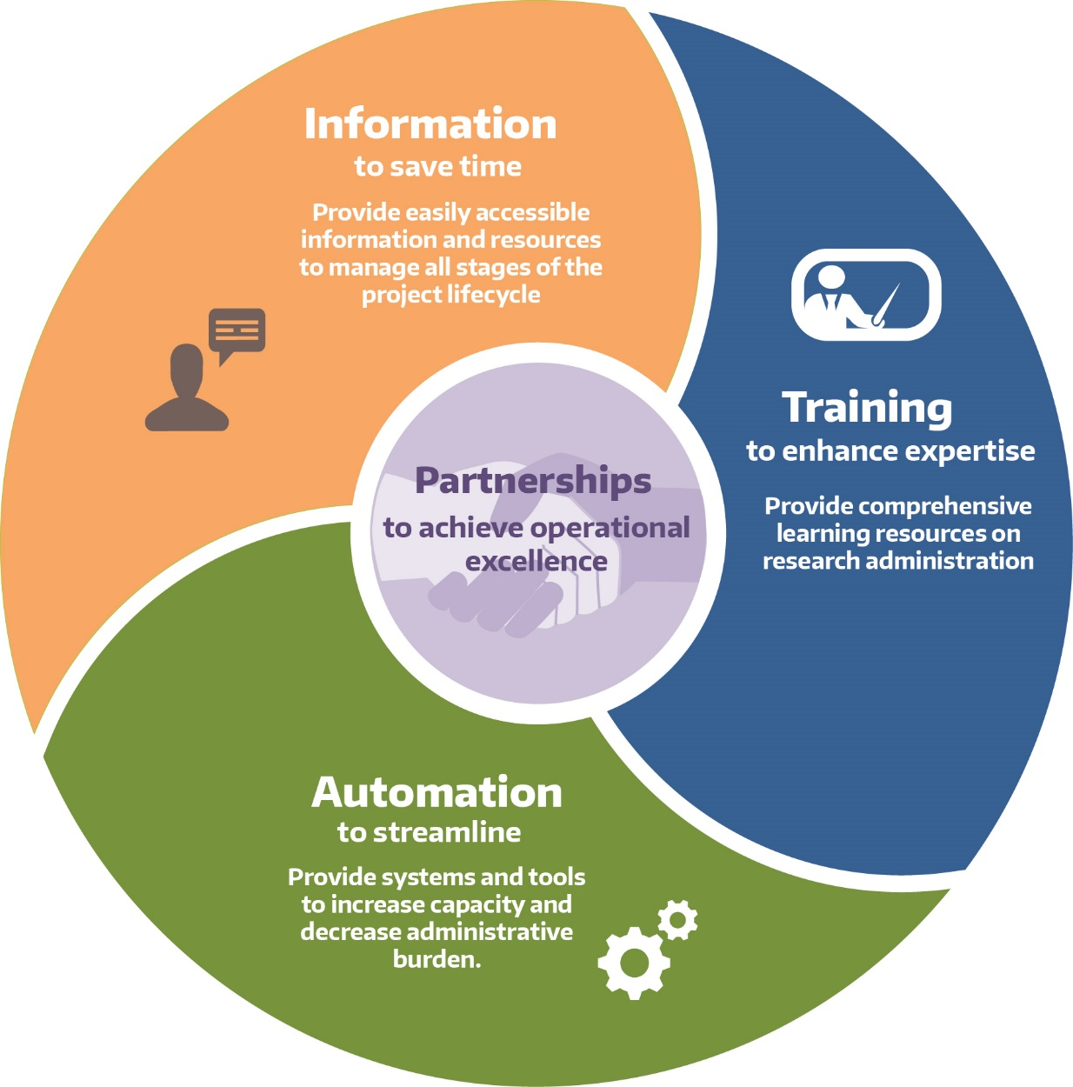

Giving Time Back to the Researcher
Building capacity in research administration
Three-part approach:
New Certificate in Research Administration to launch Fall, 2019
Function-based website
MyResearch Portal
Training transcript
Funding status
ZipLine (IRB)
HoverBoard (IACUC)
https://myresearch.washington.edu

Slide 6
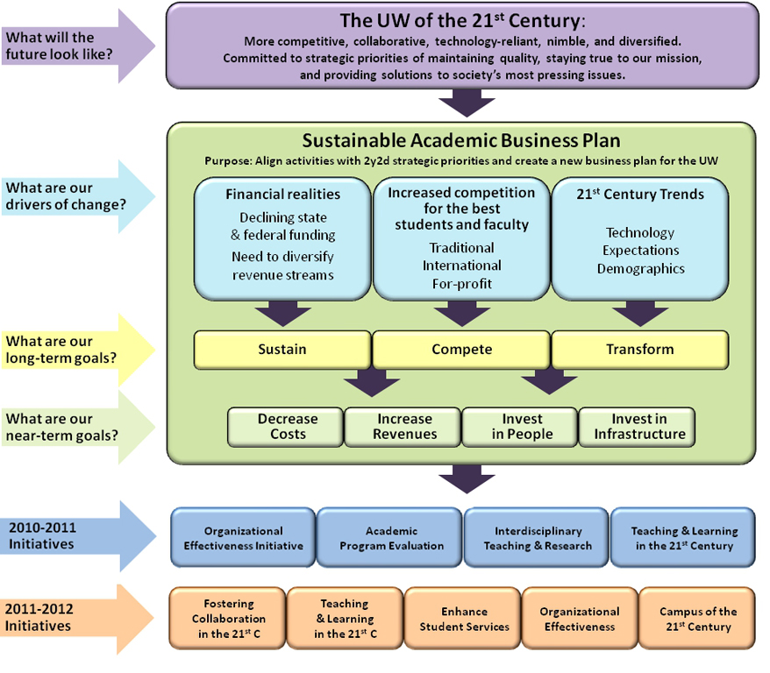
Example
Notes:
Example

Slide 7

Review of work to date: Last Year’s Deliverables
Sustainable Academic Business Plan
Align activities with our 2y2d strategic priorities
Create a new business plan for the UW
What are our near-term goals?
Increase Revenues
Decrease Costs
Invest in People
Invest in Infrastructure
Organizational Effectiveness
Academic Program Evaluation
Interdisciplinary Teaching & Research
Teaching & Learning in the digital age
2010-11 Initiatives
Conducted intake of all admin units
Provided training, consultation, facilitation, PI, PM, metrics creation, & spider mapping services
Conducted peer review
Compiled unit process improvements
Designed and implemented launch of program evaluation for all academic units in coordination with the annual budget process
Evaluated launch, collecting feedback, lessons learned
Updated process, timeline, metrics for 2011-12
Drafted best practices for joint appointments
Created guidelines & handbook for new centers
Conducted inventory of joint/adjunct appointments, courses, double majors (pending)
Piloted faculty learning communities
Drafted Center for Teaching & Learning mission, vision & values
Partnered with student tech fee on wifi & “my plan”
Planned LMS pilot in 3 locations for 2011-12
2010-11 Deliverables
Notes:
Example

